Slide 1
Project Presentation
Group 6: ASD Project Assignment
Nov/20/2020

Slide 2
Agenda
Members
WBS and Assignment
Class Diagram
Framework
Bank Application
Credit Application

Slide 3
Members
1. Duc Phuoc Doan
2. Duy Thai Nguyen
3. Yohannes Teweldeberhan
4. Biniam Tsehaye Arefaine
5. Tesfai Habtai Samuel

Slide 4
Assignments
1. Go to WBS excel file

Slide 5
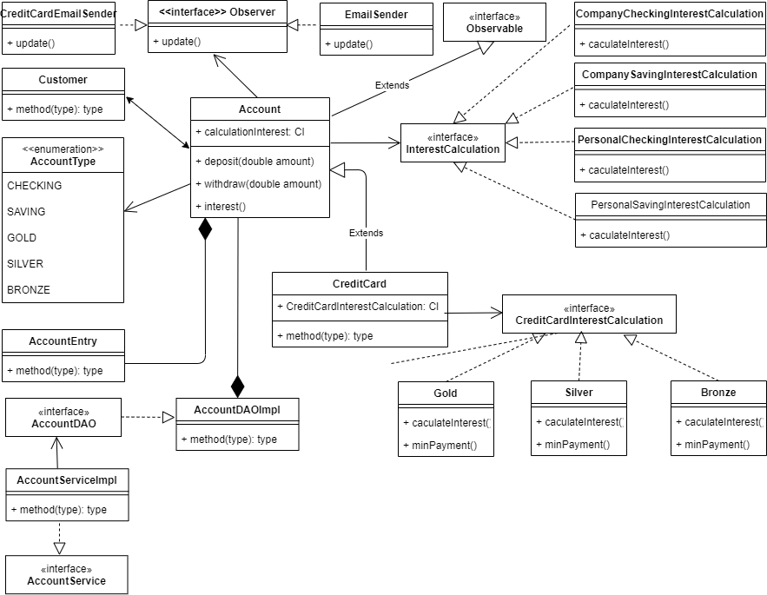
Class Diagram

Slide 6
Frameworks
1. Mr. Phuoc will do presentation

Slide 7
Bank Application
1. Create Company/Personal account
2. Deposit/Withdraw
3. Interest
4. Bank Statement
Notes:
Consider talking about:
School and university
Project management
Civil and military construction and industry infrastructure
Computer software
State project

Slide 8
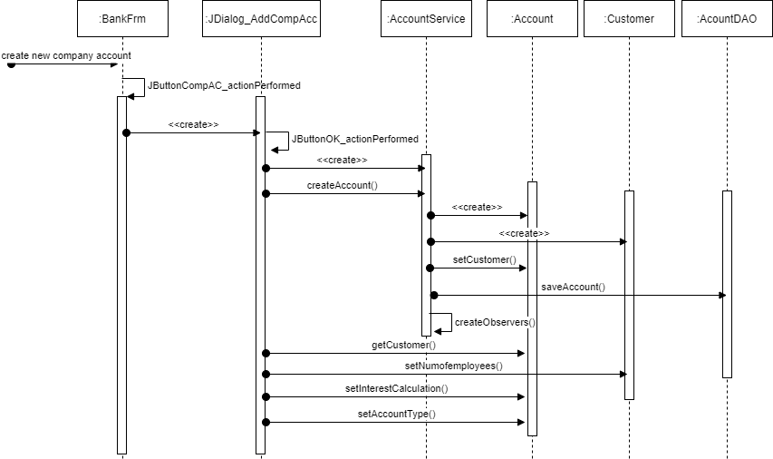
Create company/personal account

Slide 9
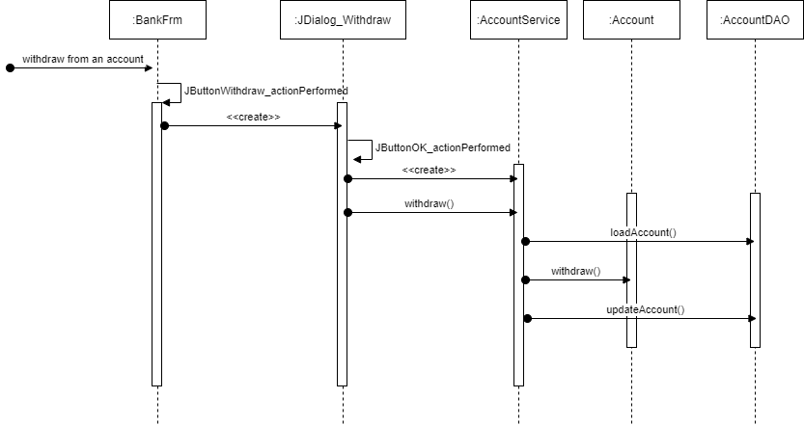
Deposit/withdraw

Slide 10
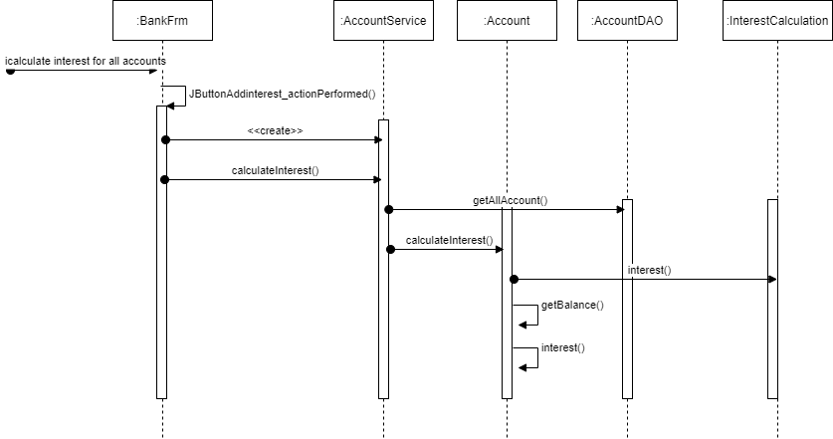
Calculate interest

Slide 11
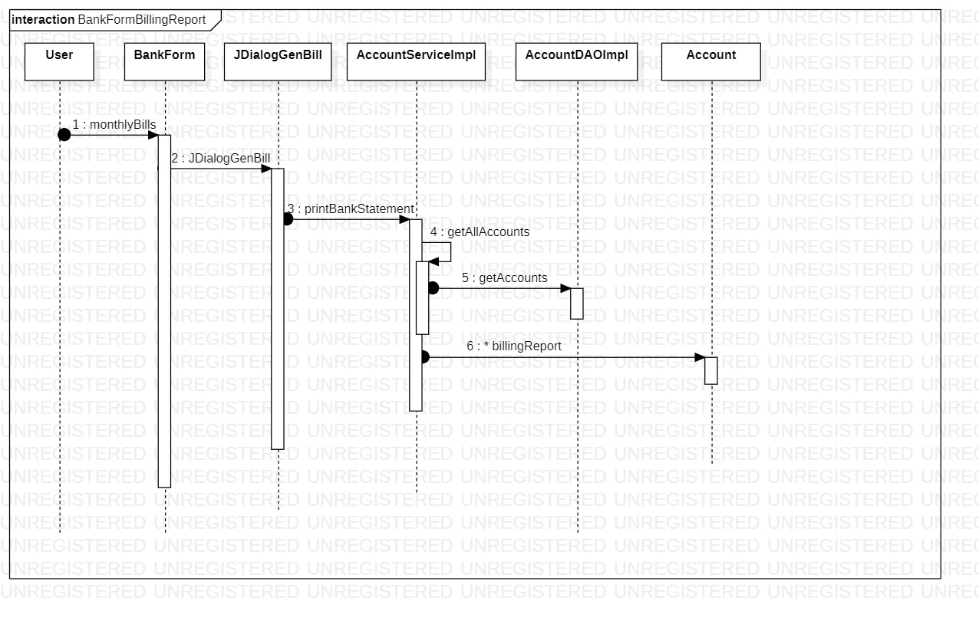
Bank Statement

Slide 12
Credit Application
1. Create Credit account
2. Deposit/Charge account
3. Billing Report
4. Interest/Min Payment Calculation
Notes:
Consider talking about:
School and university
Project management
Civil and military construction and industry infrastructure
Computer software
State project

Slide 13
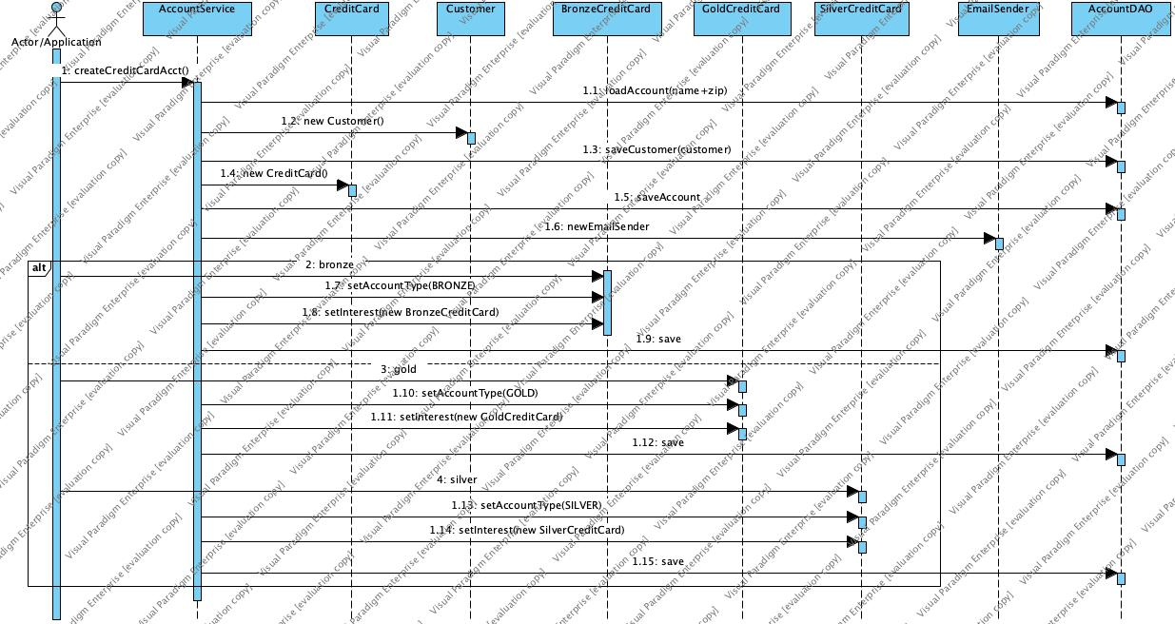
Create credit card
Biniam will do/update presentation

Slide 14
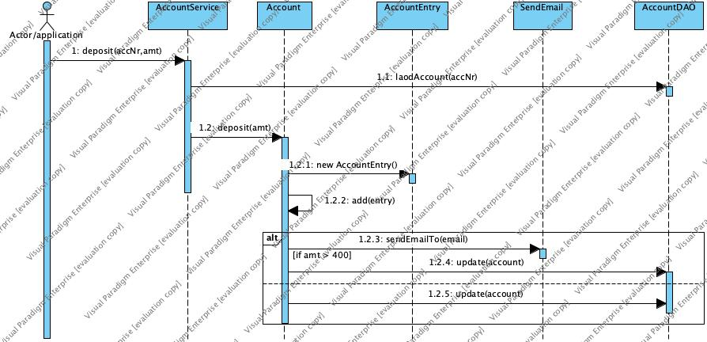
Deposit account
Biniam will do/update presentation

Slide 15
CHARGE Credit Card
Samuel will do/update presentation

Slide 16
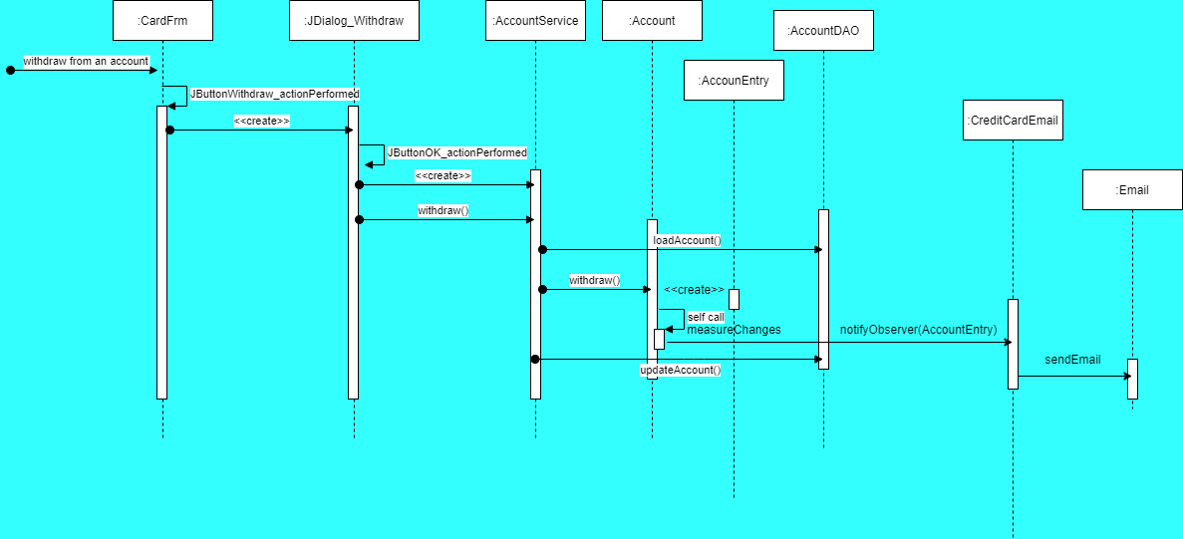
Samuel will do/update presentation

Slide 17
Billing report
Phuoc will do/update presentation

